Slide 1
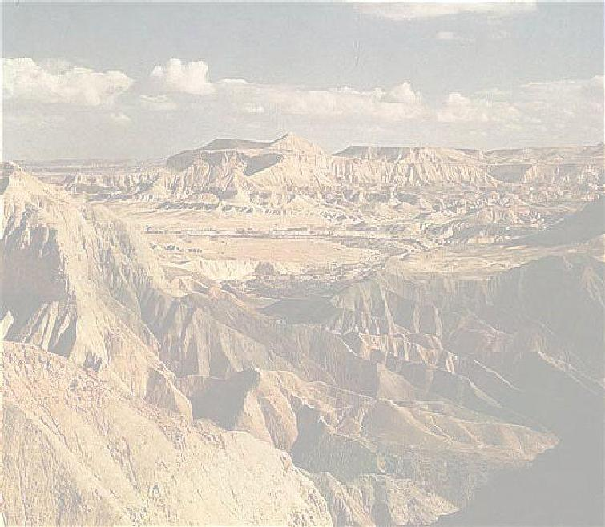
Microalgal Biotechnology
Achievements, Failures and Prospects
Avigad Vonshak
Ben-Gurion University of the Negev
The Jacob Blaustein Institute for Desert Research
Micro-Algal Biotechnology
Sede-Boqer Campus Israel
April 2020

Slide 2
Three Major components of the process
The organism/ Product
The processing / Product/
Market
The reactor

Slide 3
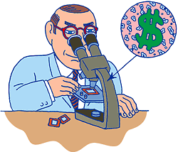
Few conclusions so far
None of the final products is the one that the concept was started with.
The beginning of the concept was with a product and not with a technology.
All the products are aimed at the high price target- high value human feed supplements.

Slide 4
Biodiesel: Some calculations on price
Lets assume that we want to be compatible when the price of a barrel of oil be oil will be 200 US $
1b= 42 gallons = 136 kg ( density of oil 0.881)
Assume we can produce at high productivity 1kg of algae with 30% oil and extraction efficiency is 100 %
1b = 136 x 3
So we need to produce 400Kg of algae in order to produce one barrel of oil.
So in order to meet the goal of 200 US $/ Barrel we need to produce 1kg of algae for 50 cents

Slide 5
The Future
Is there a lesson to be learned ?
What went wrong ?
What was done “the right way?
And…..........................

Slide 7
Product development

Slide 8
Is there an alternative ?
Fatty acids
Energy
Crude proteins
CO₂ mitigation
Beta-Carotene
Astaxanthin
Whole cells (Spirulina, Chlorella)

Slide 9
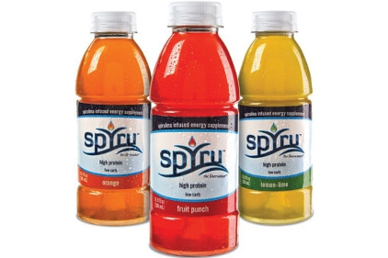
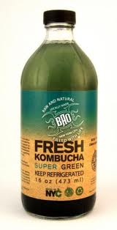
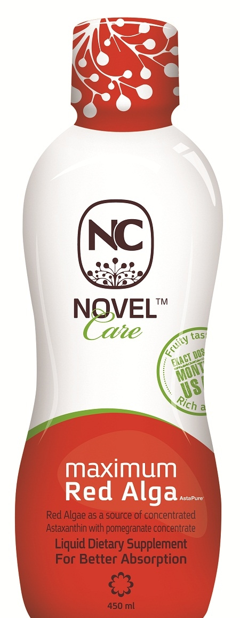
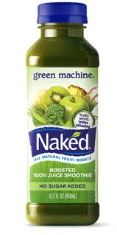

Slide 10
New York Times Magazine
October 9, 2016

Slide 13
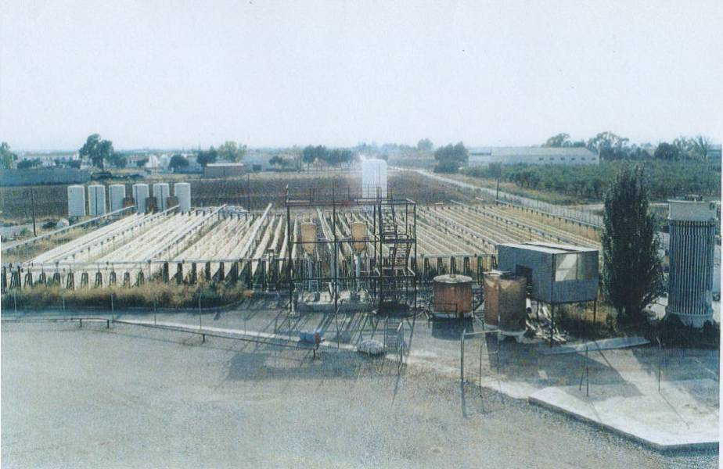

Slide 14
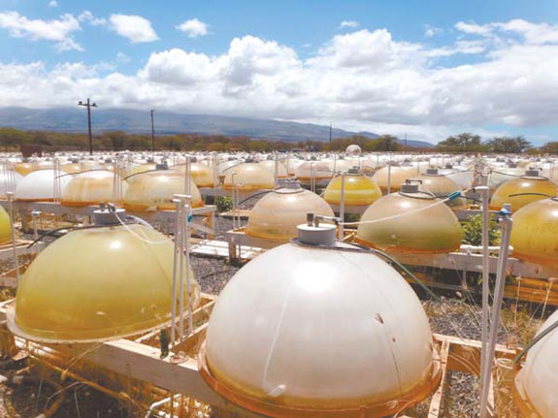

Slide 15
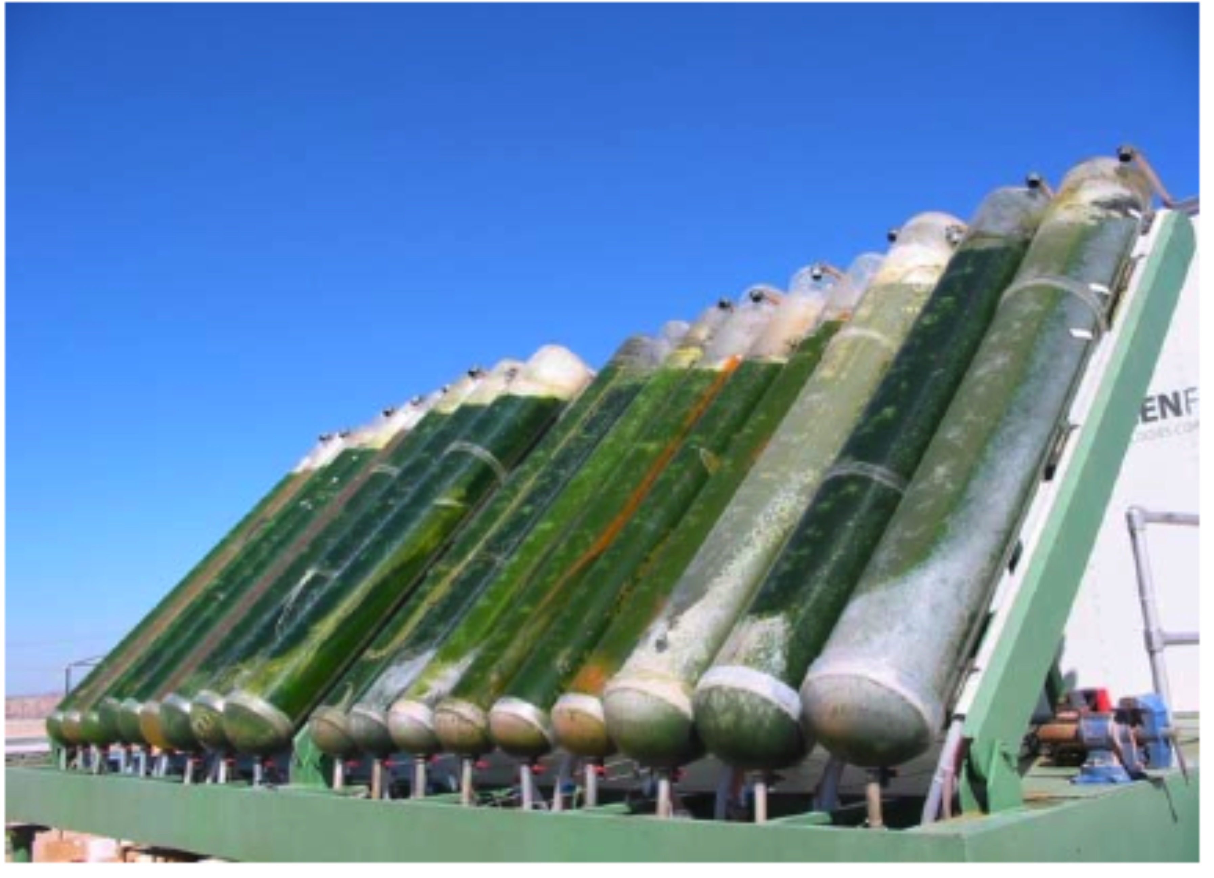
Green fuel

Slide 16
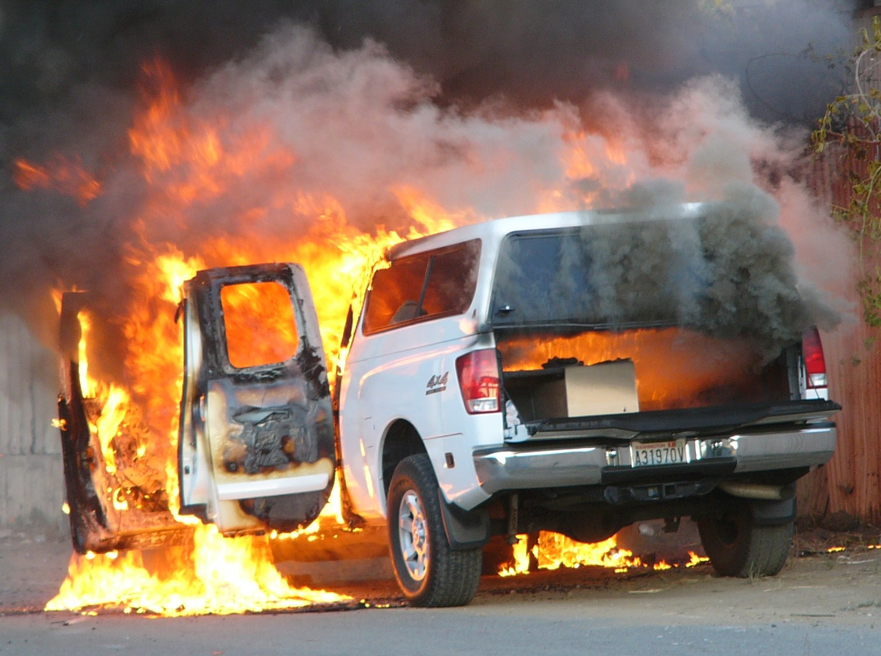

Slide 17
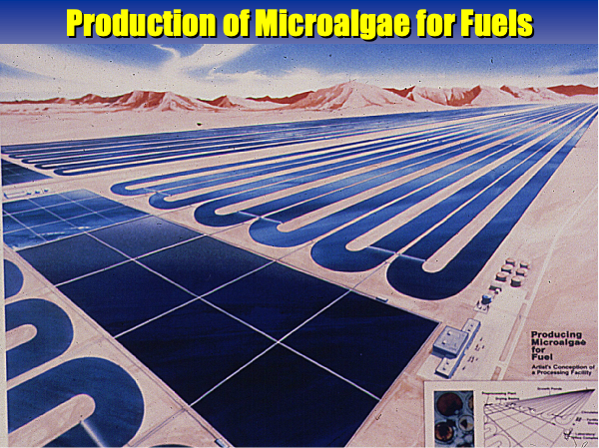
Conception of microalgae biodiesel production Aquatic Species Program, U.S. DOE NREL 1987. Note raceway growth and settling-harvesting ponds

Slide 18
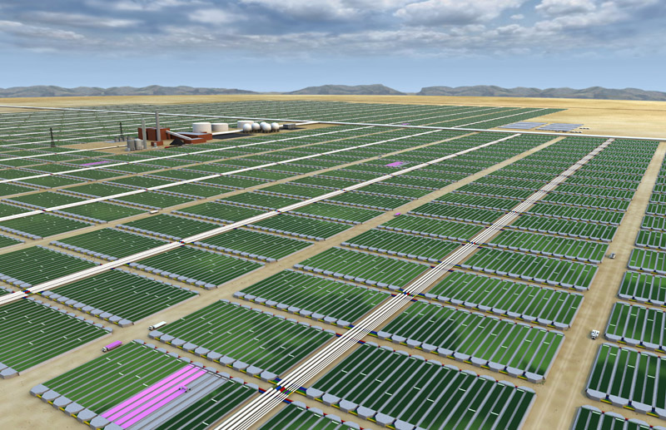
Remember using Photoshop can not replace using Photosynthesis

Slide 20
Yes we can !!!
Assuming we will do the right things
Solve the real problems
Not create new ones
Strain selecton
Nutrient efficiency utilization
Pond / Culture management
Develop systems with multiple product utilization
Avoid the use of limited resources

Slide 21
Requirements for establishing a sustainable microalgae industry
Well identified marketable products with a specific advantage over substitutes.
Appropriate strain: ease of growth, maintenence and proceeding.
Adapt the reactor to the specific strain and product and not the other way around.
Defined environmental conditions ( light, temperature) to fit the site.

Slide 22
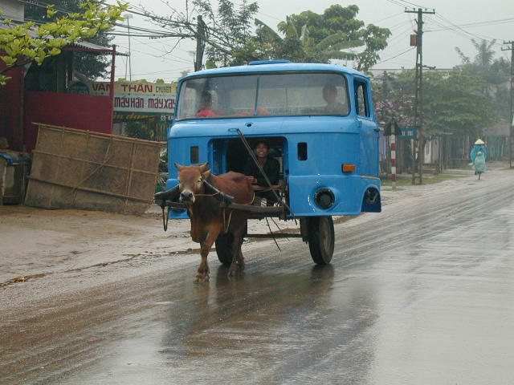
Stop dreaming and get back to work !
Just don’t do more of the same…?

Slide 23
Thank you for your attention

